Slide 1

David Bullock
Competency Portfolio
www.infratec-uk.com

Slide 2
Competency Summary
Category | Accreditation Body | No. | Expiry
Lorry Loader – Capacity up to: Unlimited Categories: D1+E | ALLMI | 257601 | 11/10/2028
Certificate, Inspection, Testing and Certification of Electrical Installations | City & Guilds | 607506942/10 | N/A
Managing Safely | IOSH | 629430 | N/A
Working at Height Level 2 (RQF) | Qualsafe Awards | 3021035 | 15/02/2026
Emergency First Aid at Work Level 3 | Qualsafe Awards | 3024688 | 14/02/2026
National Highways Safety Passport | National Highways | 14-00013918 | 06/01/2026
HERS/ ECS | CSCS | H0171501 | 19/05/2026
www.infratec-uk.com

Slide 3
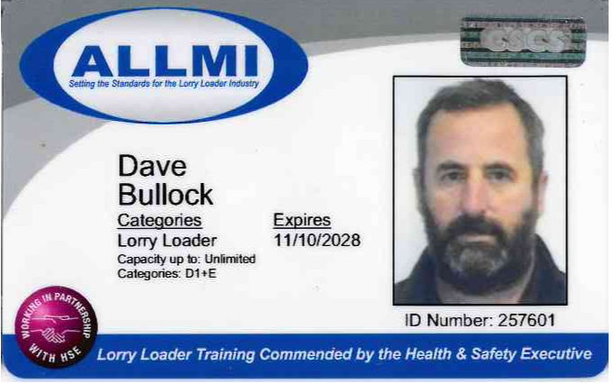
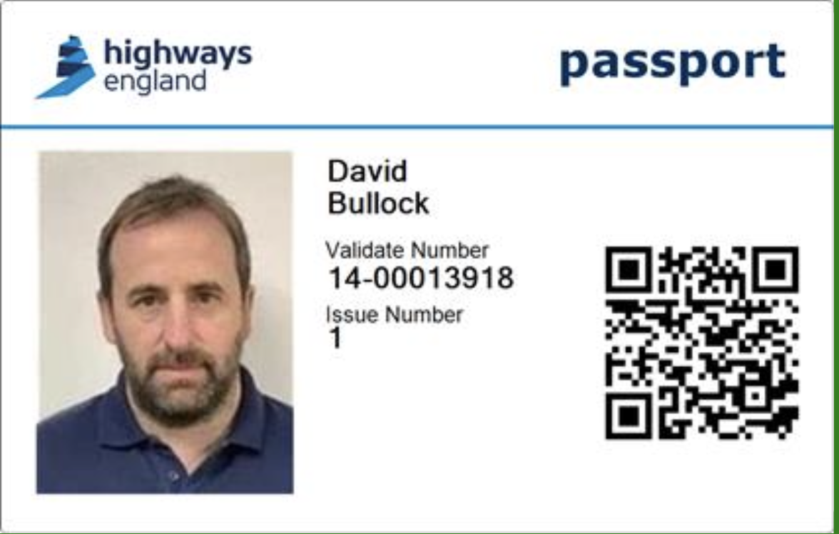
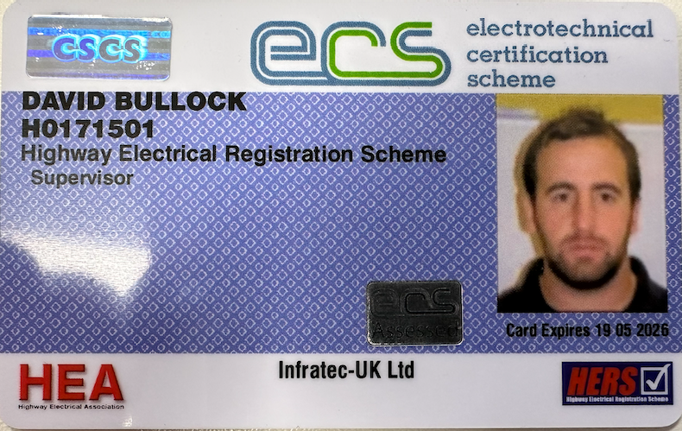
Competency Cards
Highways Passport
ALLMI
ECS
www.infratec-uk.com

